Slide 1
Finding our way to the bread of life
Luke 2:7-20

Slide 2
Staying out in the fields by night
Owner or hired hand? John 10:11, 14
Opportunity to steal from owner.
Laws of commerce
Violated purity laws. Lev 11:26
Contact with unclean animals
Laws of worship

Slide 3
Three areas restricted
Laws of commerce. No one could purchase wool, milk or lambs from shepherds in open fields.
Laws of worship. Shepherds could not worship without first being ritually “washed and cleansed.”
Laws of testimony. Shepherds could not testify in court; assumed to be liars.
“Jerusalem in the Time of Jesus,” by Joachin Jeremias (Fortress Press, 1969)

Slide 4
Rabbis’ list of “despised occupations”
Gamblers, by profession (thievery)
Usurer (lent money at high interest rates)
Pigeon fliers (racing pigeons - gambling)
Tax collector (thievery)
Shepherd (Genesis 46:33)
“Jerusalem in the Time of Jesus,” by Joachin Jeremias (Fortress Press, 1969)

Slide 5
Good news … for all the people.
Luke 2:10 – those informed of the birth:
Shepherds – lowest of the low.
Magi – highest of the high.
For you…
2:11
2:12

Slide 6
What was the Good news?
2:10: Great joy for all the people.
Comes after a God-event. Fruit of God.
Galatians 5:22
Joy of God. John 15:11, 17:13
2:17-18

Slide 7
A Savior has been born.
Luke 4:17-19 … . And He opened the book and found the place where it was written, ¹⁸ "THE SPIRIT OF THE LORD IS UPON ME, BECAUSE HE ANOINTED ME TO PREACH THE GOSPEL TO THE POOR. HE HAS SENT ME TO PROCLAIM RELEASE TO THE CAPTIVES, AND RECOVERY OF SIGHT TO THE BLIND, TO SET FREE THOSE WHO ARE OPPRESSED, ¹⁹ TO PROCLAIM THE FAVORABLE YEAR OF THE LORD."

Slide 8
How did the shepherds find their way?
They decided to go – having been informed:
… the Lord has made known to us. 2:15

Slide 9
The barriers to going:
Fear (2:10):
Fear of failure (2:12)
Fear of rejection;
others invited not let them in.
Bearers of shame.
Fear of offending others; unclean.

Slide 10
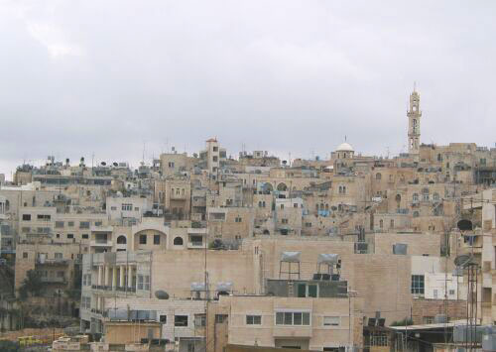

Slide 11
The barriers to going:
Practicalities of life:
Sheep: who will take care of the sheep?
Pay the bills, feed the kids.
Not in their comfort zone.
Shepherds didn’t hold babies.

Slide 12
How did the shepherds find their way?
They took the first step.
They went straight. 2:15
With haste. 2:16
Every next step was easier and faster.

Slide 13
How did the shepherds find their way?
They looked until they found the child.
2:12, 16; a baby in a manger.

