Slide 1
Faithless but Still Chosen Luke 1:1-13; 18-26

Slide 2
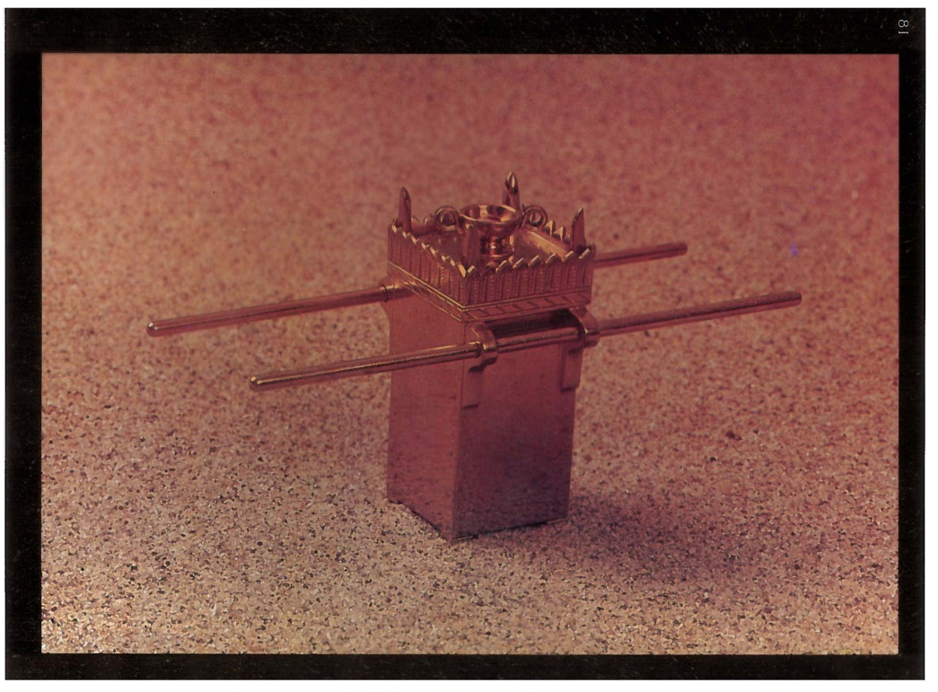
Altar of Incense

Slide 3
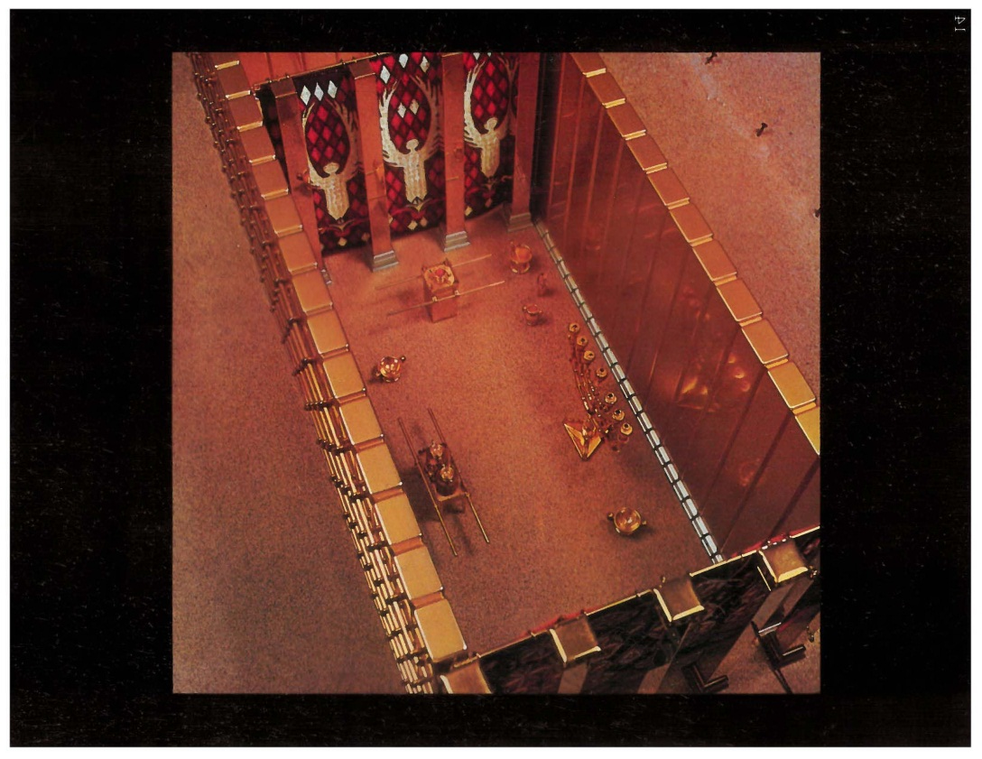
Holy Place

Slide 4
God came to Zachariah in spite of where he was spiritually.

Slide 5
Zachariah’s faithlessness did not limit Gods faithfulness.
2 Timothy 2:13
Malachi 4:5-6

Slide 6
God came to Zachariah in the midst of his faithlessness, but he did not ignore his spiritual poverty.
Luke 1:19-20, 62f
John 3:16-21

Slide 7
Christmas is a time to be reminded that God came into the darkness as light. Then he gave the light to us.
1 Peter 2:9-10

